Slide 1


REPUBLIQUE DU CAMEROUN
Paix – Travail – Patrie
-------------
UNIVERSITE DE DOUALA
-------------
ECOLE NATIONALE SUPERIEURE
POLYTECHNIQUE DE DOUALA
-------------
B.P. 2701 Douala
Tel (237) 697 542 240
Site web: www.enspd-udo.cm
REPUBLIC OF CAMEROON
Peace – Work – Fatherland
-------------
THE UNIVERSITY OF DOUALA
-------------
NATIONAL HIGHER POLYTECHNIC
SCHOOL OF DOUALA
-------------
P.O. Box: 2701 Douala
Phone: (237) 697 542 240
Email: contact@enspd-udo.cm
CONCEPTION AND REALIZATION OF AN APPLICATION THAT INTEGRATES ARTIFICIAL INTELLIGENCE, CAPABLE OF ANALYZING SENTIMENTS, FORECASTING SALES, PREDICTING PRICES, AND GENERATING A CHATBOT
COMPUTER ENGINEERING AND TELECOMMUNICATIONS
Presented by:
NGALI ABIRU NDINAKIEH
Under the professional supervisor of:
Mr MESSI CHARLY
Under the academic supervisor of:
Dr SAMUEL EKE

Slide 2

PLAN
2
01
Introduction
02
State of the art
03
Presentation of projet
04
Realisation an interpretations
05
Discussions and impact
05
Conclusion

Slide 3
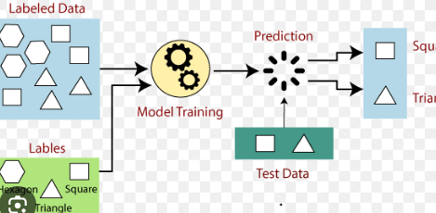
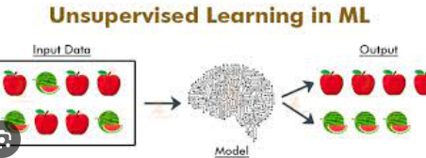
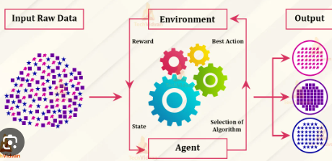
Introduction
3
What is Artificial Intelligence and machine learning?
What does artificial intelligence do at its core?
Categories of AI and ML
Supervised
Unsupervised
Reinforcement

Slide 4


4
PROBLEM
Why this project?.
Maximisation and optimisation problem

Slide 5

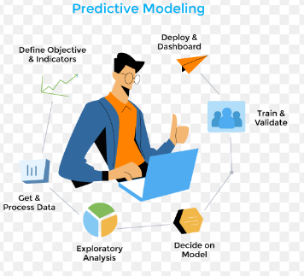

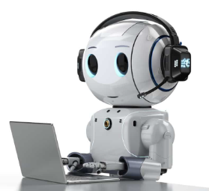
5
Objectives of this studies
Sales forecasting
Price prediction
Sentiment analyzer
chatbot

Slide 6
6
Actors
Clients
manager

Slide 7

Functionalities
7
Forecasting sales
Predicting prices
Get inquiries
Analysing sentiments

Slide 8
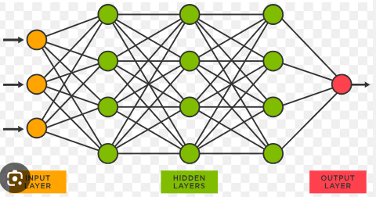
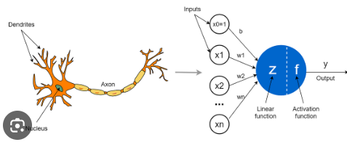
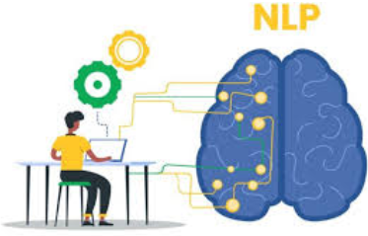
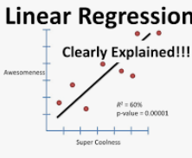
The science behind the scene
Neural network(NN)
Convolutional NN
Recurent NN
Natural language processing
Linear regression

Slide 9
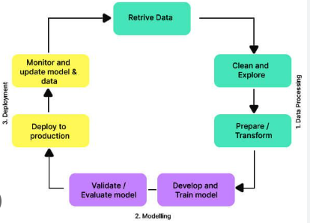


Methodology
UI
API
MODEL
Data science workflow

Slide 10










Tools

Slide 11

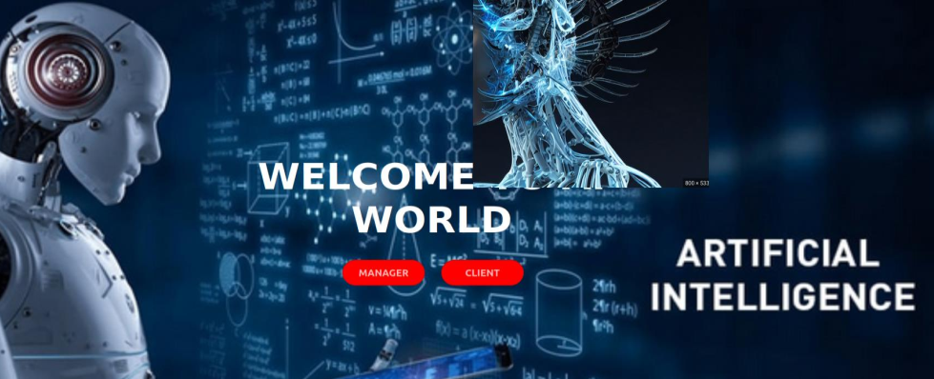
Presentation of the projet
AI WORLD home page
Put your app screen

Slide 12
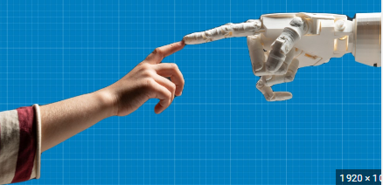

11
Demonstration
AI-WORLD

Slide 13
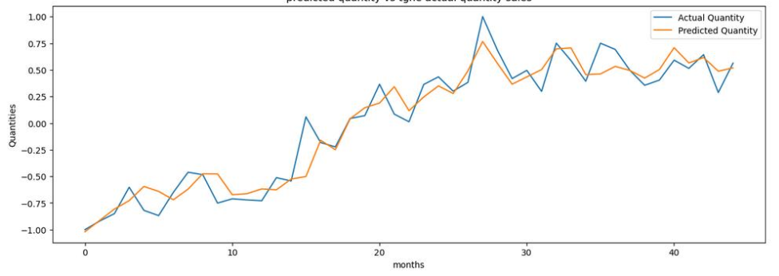
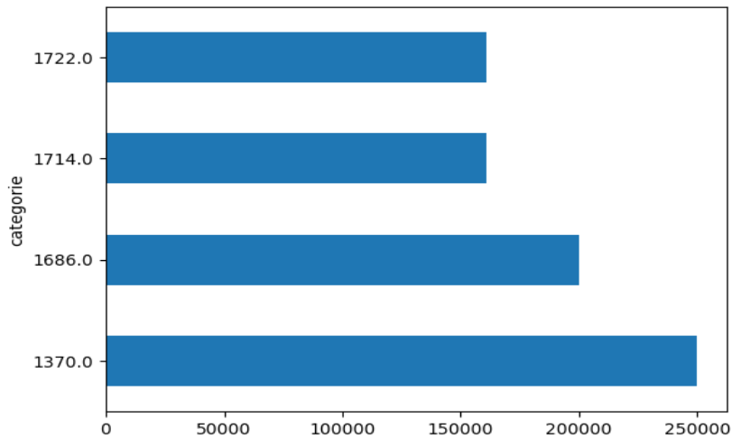
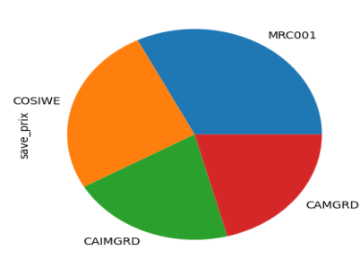
Results et Analysis

Slide 14
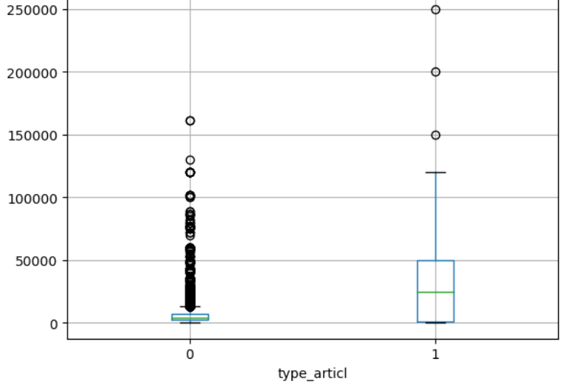
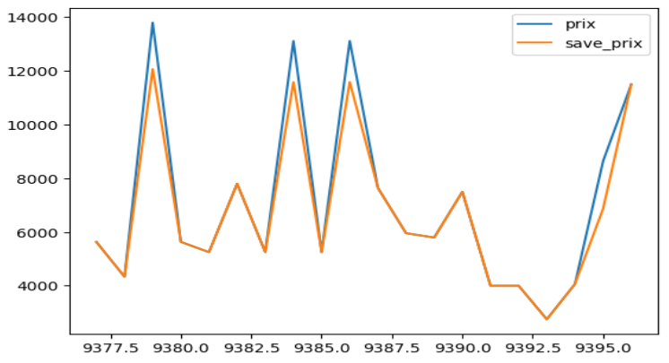
Results et Analysis

Slide 15



IMPACT OF THE STUDY
Customer satisfaction
Profits maximisation

Slide 16
FUTURE WORK
ADDITIONAL FUNCTIONAL ITES
Chatbot limitations
SECURITY
IMPROVE SITE PERFORMANCE
Enhance the site security
DB performance is quite low

Slide 17
CONCLUSION

Slide 18
THANKS FOR YOUR KIND ATTENTION

